Slide 1
DESIGNING CIRCUIT IN SOFTWARE Project : IOT BASED SMART PARKING USING BEAGLEBONE BLACK WIRELESS
SUBMITTED BY:
MERLIN MARIAM THANKACHAN (C0748721)
Group #1

Slide 2
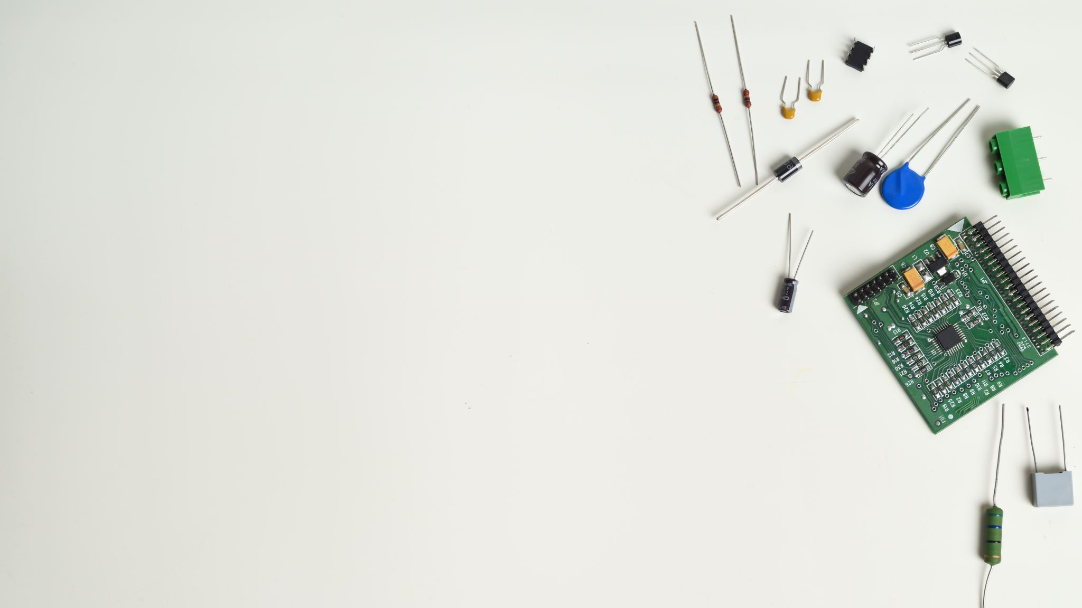
CONTENTS
Introduction.
Creating new project in EasyEDA
Steps to add and connect components
Interfacing Beaglebone Wireless with HC-SR04 ultrasonic sensor.
Interfacing Beaglebone Wireless with 28BYJ-48 Stepper motor.
Interfacing Beaglebone Wireless with GPS Module.
Interfacing Beaglebone Wireless with LCD.
Schematic diagram.
References.

Slide 3

INTRODUCTION
EasyEDA is an easier and powerful online PCB design tool that allows to design and share projects.
More than 1 million free libraries are available
It provide work anywhere, anytime feature with its online version.
It gives real time team cooperation
It provide direct link to electronics components for selection.
Document export in the form of png, pdf, jpeg and so on is available
It provide integrated PCB Fabrication

Slide 4
Creating new project in EasyEDA
Download EasyEDA software.
Create new project.
Add schematic diagram page.
Search and add components from library.
Draw connection between the terminals.

Slide 5
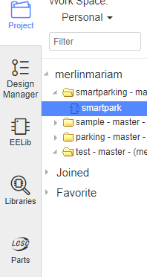
STEPS TO ADD AND CONNECT COMPONENTS
Search components like beaglebone black, ultrasonic sensor, GPS module in the ‘libraries’ tab.
Search for other components such as resistors, potentiometer, Vcc in the ‘EELib’ tab.

Slide 6
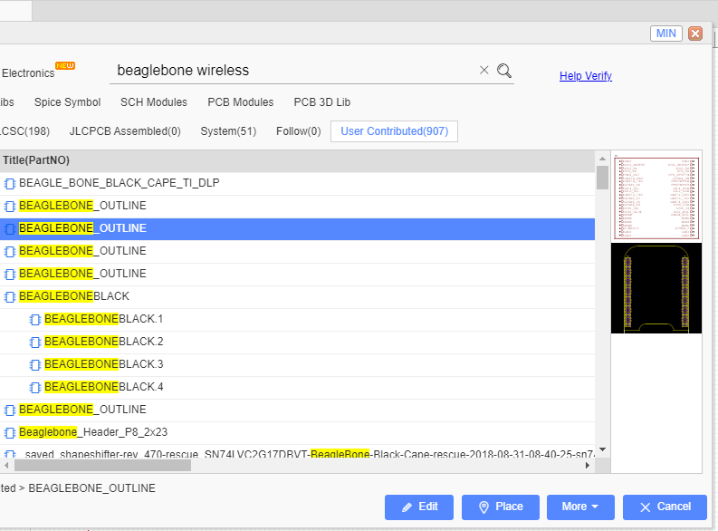
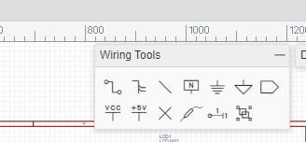
Select the desired component from the available options and click on ‘place’ the component.
Use ‘wiring tool’ tab on the top for options to connect the components.

Slide 7
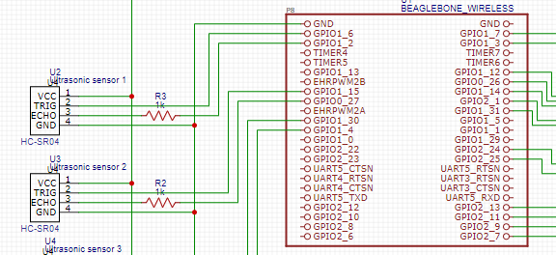
Interfacing Beaglebone Wireless with HC-SR04 Ultrasonic sensor.
VCC is connected to power supply and GND pin to the GND of beaglebone wireless.
Output from ECHO pin is connected to one of the GPIO pins through a resistor.
Input from GPIO pin of Beaglebone wireless is fed to TRIG pin of ultrasonic sensor.

Slide 8
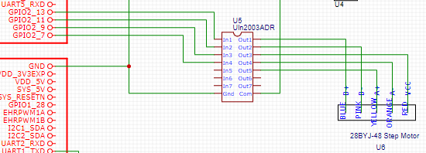
Interfacing Beaglebone Wireless with 28BYJ-48 Stepper motor
The GPIO pins of BBB is fed to the motor driver Uln2003 at the pins ‘In 1’ to ‘In 4’.
The outputs ‘Out1’ to ‘Out5’ from driver is fed to the pins of stepper motor.
Com terminal for driver module is connected to VCC
GND terminal is connected to GND of beaglebone

Slide 9
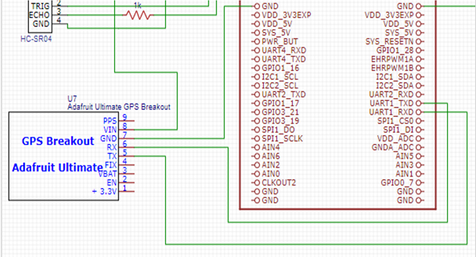
Interfacing Beaglebone Wireless with GPS Module.
RX pin of GPS module is connected to UART1_RXD0 pin of beaglebone black wireless.
TX pin of GPS module is connected to UART1_TXDO pin of beaglebone black wireless.
From the GPS module Vin is connected to the power supply and GND to the GND of beaglebone wireless

Slide 10
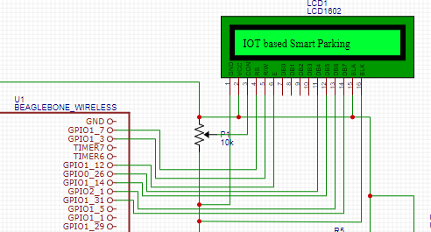
Interfacing Beaglebone Wireless with LCD
R/W pin and enable pin are connected to GPIO pins of beaglebone wireless.
Data pins from D4-D7 are connected to GPIO pins of BBB wireless
Backlight anode pin is connected to VCC and cathode is connected to gnd.
CON pin of LCD is connected to a potentiometer to adjust the contrast.

Slide 11

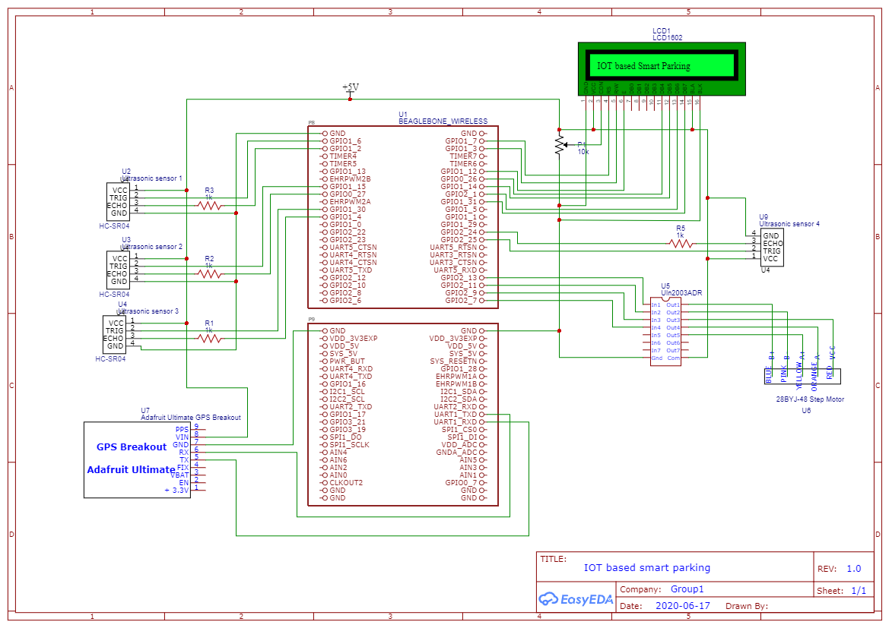
Overall Schematic Diagram

Slide 12
REFERENCES
1. EasyEDA (ND) EasyEDA Retrieved from.
https://easyeda.com/page/about
EasyEDA tutorial, an easier and powerful online designing tool, Retrieved from :
https://docs.easyeda.com/en/Introduction/Schematic-Capture/index.html

